Slide 1
Pandemic Comparisons
COVID-19
Mark Hinkle, Ryan Gjerset, Yin Cai, Zack Snyder

Slide 2
Core Message | Hypotheses
Our group wanted to bring forth information on the recent COVID-19 (Coronavirus) outbreak.
Additionally, we wanted to generate comparisons against one of the previous epidemics we experienced in our own lifetimes, the SARS virus.
Using the following joint and supplemental data sources, we explored a category of COVID-19 and generated comparisons to SARS where applicable.
Supplemental Data Sources
World Bank 65+ Population
2020 World Population
2018 World Median Ages
2018 World Bank Income Classifications
COVID-19 Testing Data
Joint Data Sources
COVID-19 Dataset
SARS 2003 Outbreak

Slide 3
Categories of Exploration & Comparison
Geography
To compare the geographic spread of the SARS and COVID19 data and statistics
Transmission Rate
We analyzed the rate of transmission during the first 50 days of each epidemic
Income
We analyzed the effect COVID-19 has on countries based on their income levels.
Age Impact
We would like to know if age has an impacted on COVID-19 confirmed cases and death rate
*due to lack of age data and geographic spread constraints of SARS we are only looking at age impact on Covid-19

Slide 4
Geography

Slide 5
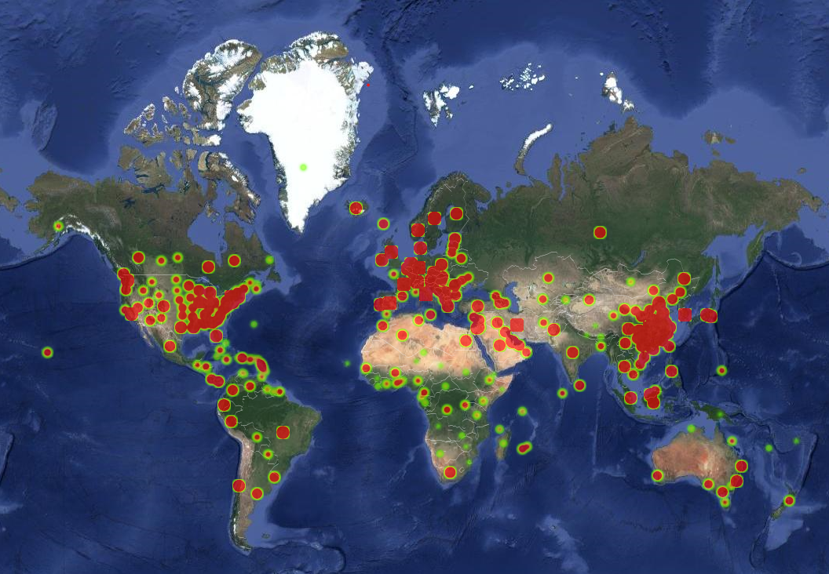
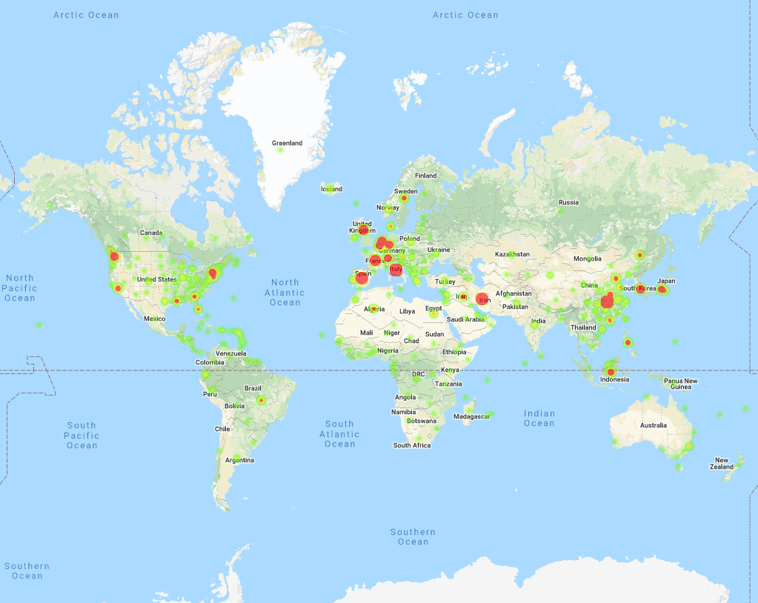
2002 SARS Contagion vs COVID19
COVID 19 Confirmed Cases by Province, Country
SARS Confirmed Cases by Country
While the SARS epidemic has spread to 34 countries from November 2002 to July 2003, the COVID 19 Virus spread to 162 counties between December 2019 and March of 2020..
This purports that Corona virus replicates and infects quicker that SARS
*COVID19 Data is as of 3/21/2020
*The SARS outbreak lasted roughly from Nov ‘02 - July ‘03

Slide 6
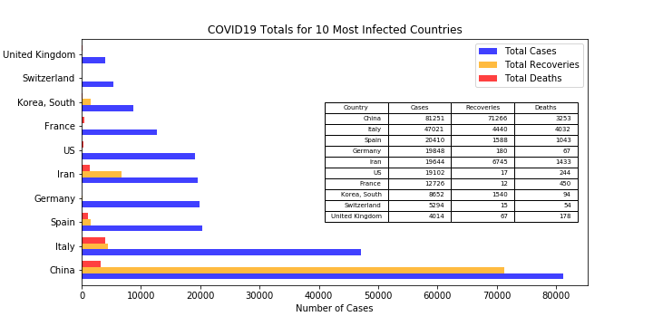
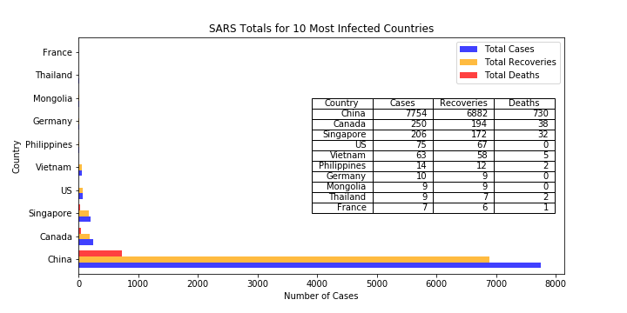

Statistical Comparison - COVID19 vs SARS by Geography
The summary statistics indicate a low recovery rate for COVID19 compared to that of SARS - this is due to the fact that a large proportion of confirmed cases are still being treated.
A distribution of the data indicates regionally where cases for both viruses are localized.
  In the case of SARS, a majority of the cases were isolated to specific regions in Asia, Europe, and North America

Slide 7
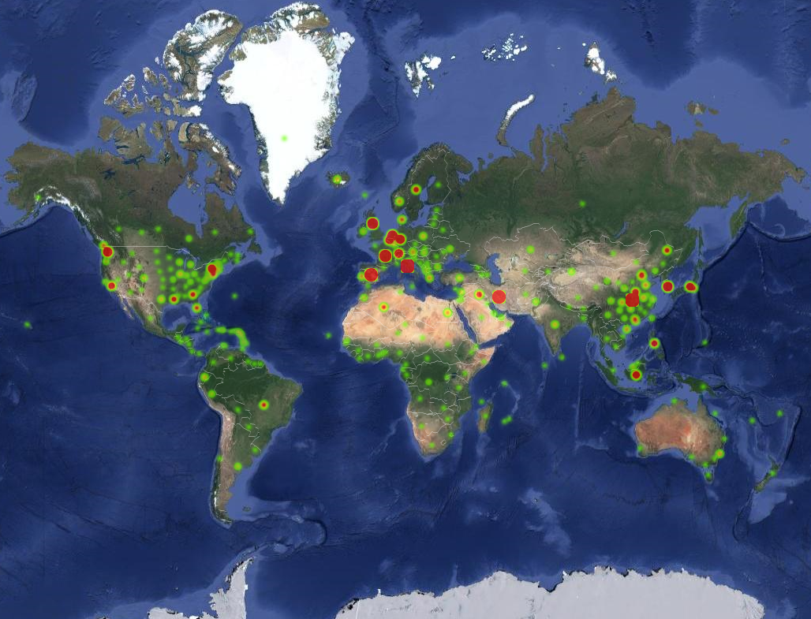
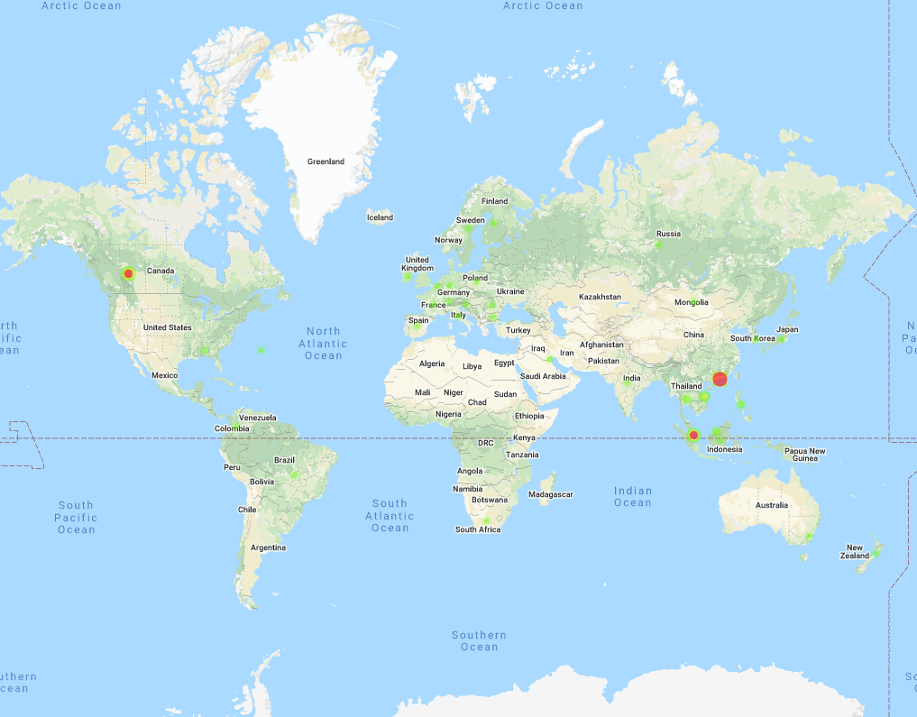
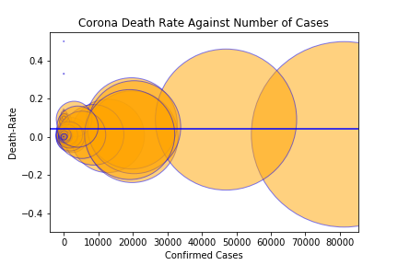
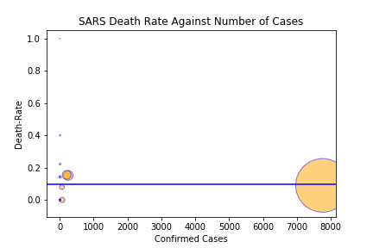
Death Rate Comparison - SARS vs COVID19 - by Country
Regarding the information
We created the two scatter plots shown to try to identify outliers for geographic areas that may have death rates that are inconsistent with the mean death rate of the entire population (shown by the blue line for each virus)
Take-Aways:
Overall the spread of the virus is consistent with the map of the overall contagion.
While the spread of death tolls is compelling, an average of total death rates actually shows that confirmed cases of the virus are statistically less deadly than SARS
In the case of SARS, the dataset was heavily leveraged by confirmed cases in China

Slide 8
Transmission Rate

Slide 9
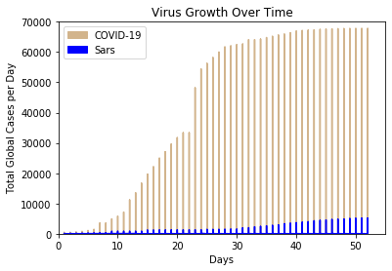
Transmission Rate
Key Takeaways
Significant variance in volume of confirmed cases
Flattening of Confirmed Cases Curve
The rate of transmission is far greater for COVID-19 than for Sars. It is speculated that this phenomenon has less to do with the strength and invasiveness of COVID-19 and more to do with the evolution of societies since the Sars outbreak in 2002.
Rapid globalization of economies
Increase in the affordability and frequency of long distance travel.

Slide 10
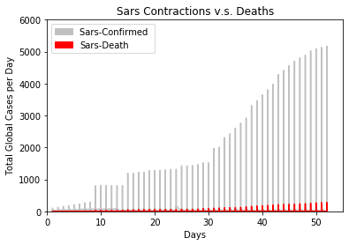
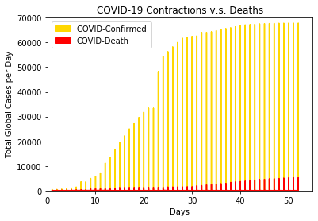
The virus’ are similar in that their kill rates are both extremely low relative to their infection rate.
The kill rate of COVID-19 is approximately 14%
The kill rate of Scars was approximately 6-7%.
Inverse Curve Structures

Slide 11
Income

Slide 12
Comparison 3 | Income
Hypothesis
Countries with smaller income levels will be impacted worse by COVID-19 than countries with larger incomes levels.
Initial Measurements for Hypothesis Testing
Income
World Bank Analytical Classifications of Country Wealth.
Impact of Covid-19
Conduct an ANOVA test comparing Confirmed Cases across Wealth Groups.

Slide 13
Income (cont.)
Classifying a Country’s Income
Income Classification | Threshold (GNI per capita in $) | % of Total Countries
Low Income (L) | <= $1,025 | ~14%
Lower Middle Income (LM) | $1,026 - $3,995 | ~22%
Upper Middle Income (UM) | $3,996 - $12,375 | ~28%
High Income (H) | > $12,375 | ~38%
Source: 2018 World Bank Income Classifications

Slide 14
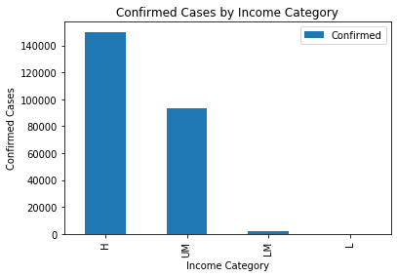

Income (cont.)
Confirmed Cases by Country Income Category
Income Category | Confirmed Cases
High (H) | 150,033 (61%)
Upper Middle (UM) | 93,508 (38%)
Lower Middle (LM) | 2,222 (1%)
Low (L) | 141 (<1%)
Observation
Lower Income countries are disproportionately affected less by COVID-19 than wealthier countries.
Next Step
Identify a connection between a country’s income level and the COVID-19 tests they’ve conducted.

Slide 15
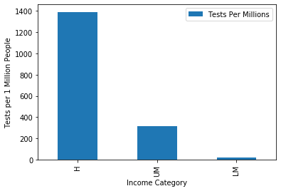
Income (cont.)
Conducted COVID-19 Tests by Country Income Category
Income Category | Tests Conducted (per Million)
High (H) | 1,392
Upper Middle (UM) | 317
Lower Middle (LM) | 18
Low (L) | 0
Observation
As you move down the Income Categories the prevalence of testing diminishes.
Takeaway
Potentially due to the cost of testing, the number COVID-19 confirmed cases from lower income countries could be vastly underestimated.
Source: Ourworldindata.org

Slide 16
Age Impact

Slide 17
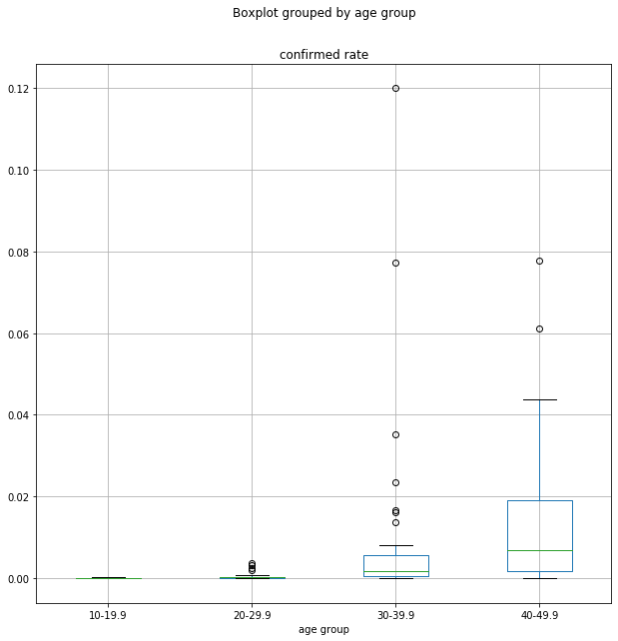
Null Hypothesis for Ages
-There is no differences between confirmation rate and age groups for Covid-19
P-value=0.000547305845934365
Conclusion:
There is strong evidence suggesting the correlation between age groups and confirmed rate.
As shown in the boxplot, the highest confirmed rates were reported in countries that have median age above 40.

Slide 18
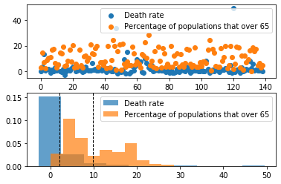
Null Hypothesis for Ages
-There is no statistically significant relationship between death rate and countries which have the largest age group that over 65 years old for Covid-19.
Conclusion:
There is very strong statistically significant relationship between death rate and countries which have largest age group that over 65 years old.
Covid-19 could be fatal to all age group but is causing devastated consequences to countries with larger population of aged group such as Italy and Spain.

Slide 19
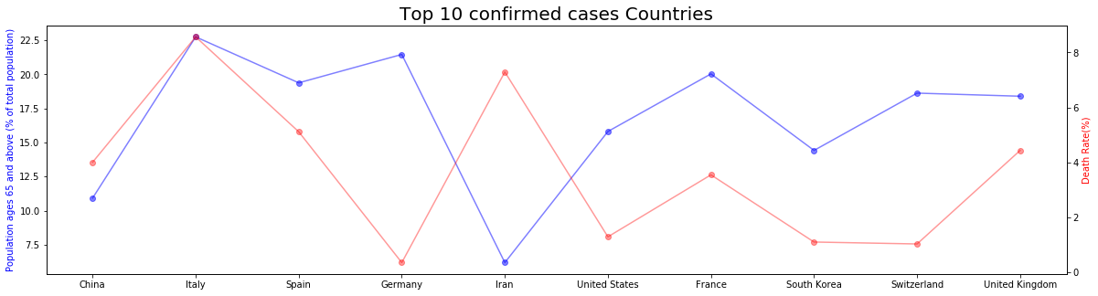

Age examples - Top 10 most affected countries
Most of the top 10 countries follow the correlation between population ages 65+ percentage and Death rate %
Exceptions are Germany and Iran
Factors that causing the differences

Slide 20
Future Considerations
Use of live data sets as opposed to fixed data sets
We used fixed data sets for our analyses. This skews the accuracy of our findings related to COVID-19 because our data becomes less and less relevant as each day passes.
Other factors that impact the death rate for different countries
Economic Level
Strikes to Health Care System
Availability of Test Kits globally
Regional Factors that contribute to the spread of COVID19
Measures that were not taken during SARS outbreak
Government reactions and real-time solutions (spend)

Slide 21
THANK YOU

Slide 22
APPENDIX/Resources

Slide 23
Hypothesis
Our group, using statistical analysis, wanted to bring forth information on the recent COVID-19 (Corona Virus) outbreak as a comparison against one of the previous epidemics we experienced in our own lifetimes, the SARS virus.
The prevalence of the Corona Virus after nearly three months has already dwarfed that of prior outbreaks. Our assertion is to compare death and recovery tolls to that of the SARS outbreak from 2002-2003.
While the Corona Virus is clearly more contagious that prior outbreaks, we can still use SARS as a template for forecasting future contagion figures and give people a more realistic understanding of the risks and dangers of contracting the virus.

Slide 24
Data Sources
Covid-19 Complete Dataset (last update 3/20/2020) https://www.kaggle.com/imdevskp/corona-virus-report
Population ages 65 and above (% of total population) https://data.worldbank.org/indicator/SP.POP.65UP.TO.ZS
Countries by Median Age 2018 https://worldpopulationreview.com/countries/median-age/
SARS 2003 Outbreak Complete Dataset https://www.kaggle.com/imdevskp/sars-outbreak-2003-complete-dataset
World Population 2020 https://worldpopulationreview.com

Slide 25
Data Sources
Supplemental Data Sources
World Bank 65+ Population
2020 World Population
2018 World Median Ages
2018 World Bank Income Classifications
Covid-19 Testing Data
Joint Data Sources
Covid-19 Dataset
SARS 2003 Outbreak

Slide 26
Future Considerations
Use of live data sets as opposed to fixed data sets.
  We used fixed data sets for our analyses. This skews the accuracy of our findings related to COVID-19 because our data becomes less and less relevant as each day passes.
Other factors that impact the death rate for different countries
  Economic Level
  Strikes to Health Care System
  Availability of Test Kits globally
  Regional Factors that contribute to the spread of COVID19
  Measures that were not taken during SARS outbreak
  Government reactions and real-time solutions (spend)

Slide 27
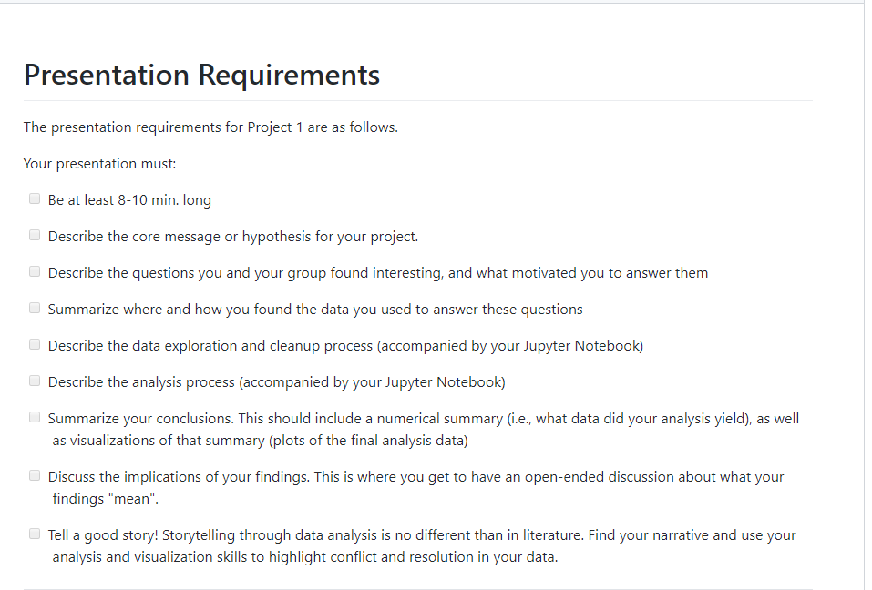
Requirements
Notes:
Be at least 8-10 min. long
Describe the core message or hypothesis for your project.
Describe the questions you and your group found interesting, and what motivated you to answer them
Summarize where and how you found the data you used to answer these questions
Describe the data exploration and cleanup process (accompanied by your Jupyter Notebook)
Describe the analysis process (accompanied by your Jupyter Notebook)
Summarize your conclusions. This should include a numerical summary (i.e., what data did your analysis yield), as well as visualizations of that summary (plots of the final analysis data)
Discuss the implications of your findings. This is where you get to have an open-ended discussion about what your findings "mean".
Tell a good story! Storytelling through data analysis is no different than in literature. Find your narrative and use your analysis and visualization skills to highlight conflict and resolution in your data.

